Slide 1

Virtual reality in education
Vytenis Kriščiūnas IFF-1/1

Slide 2
Contents
What is virtual reality?
Main benefit
Pre-developed educational VR applications
Student development of virtual worlds
What has been found?
Important to understand
Constructivist learning
Virtual worlds
Student use of pre-developed virtual worlds examples
Student development of virtual worlds example
Completed evaluations on the use of pre-developed virtual worlds
Evaluations of students-development of virtual worlds
Conclusion

Slide 3
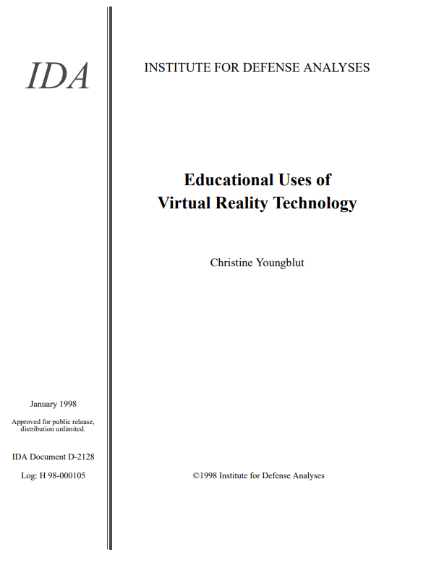

Slide 4
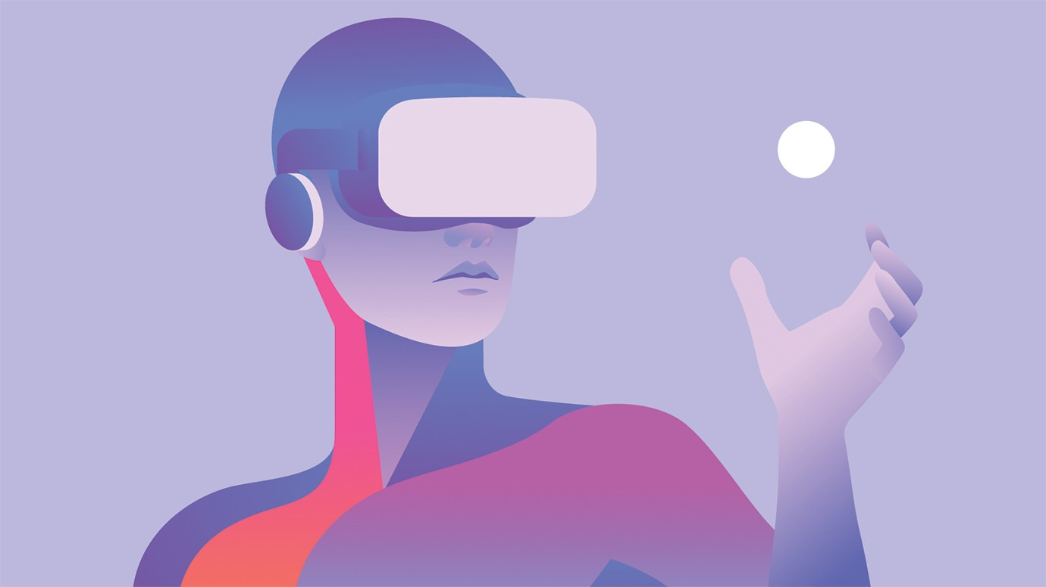
What is virtual reality?
Virtual reality (VR) – is a simulated experience that can be similar to or completely different from the real world.

Slide 5
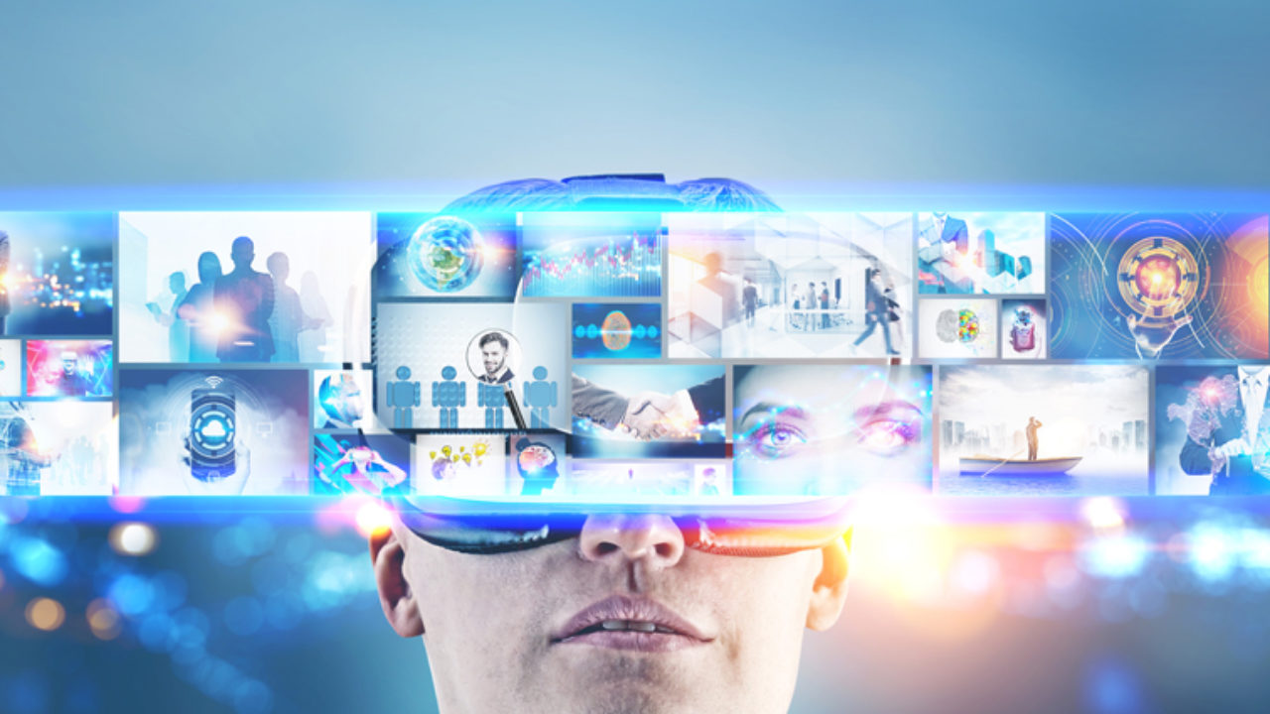

Main benefit
Visualize abstract concepts, to observe events at atomic or planetary scales and to visit enviroments and interact with events that distance, time, or safety factors make unavailible.

Slide 6
Till 1998 an estimated twenty or more public schools and colleges, and many more have been involved in evaluation or research efforts.
The first practical use of an educational VR application that has been identified occurred in 1993.
People who did evaluations where researchers and teachers.

Slide 7
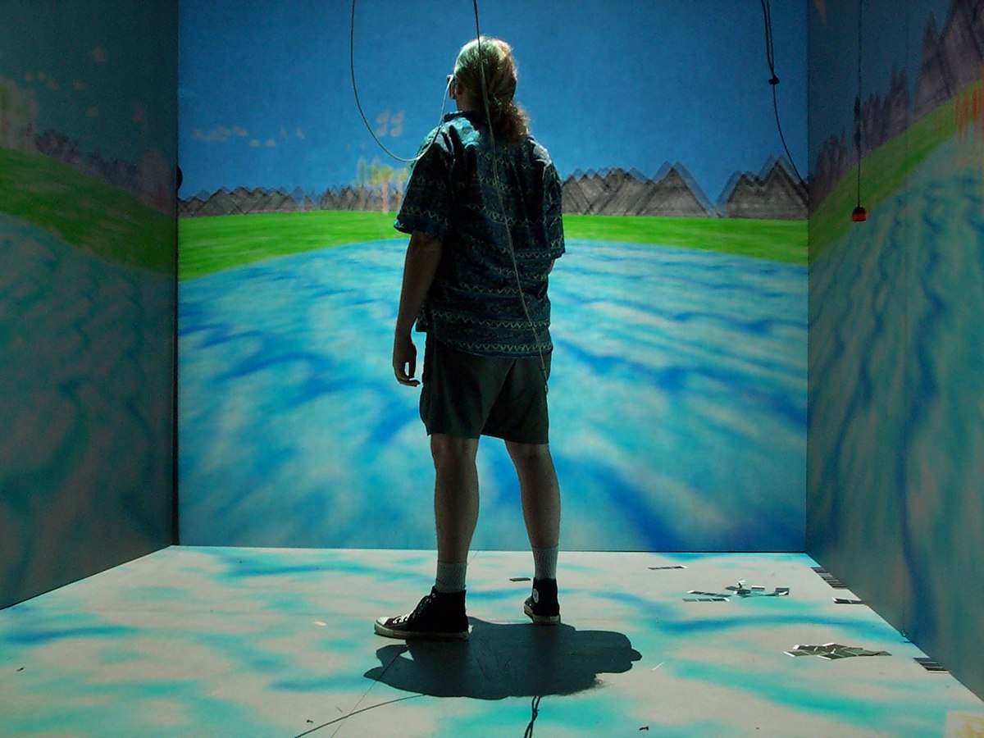
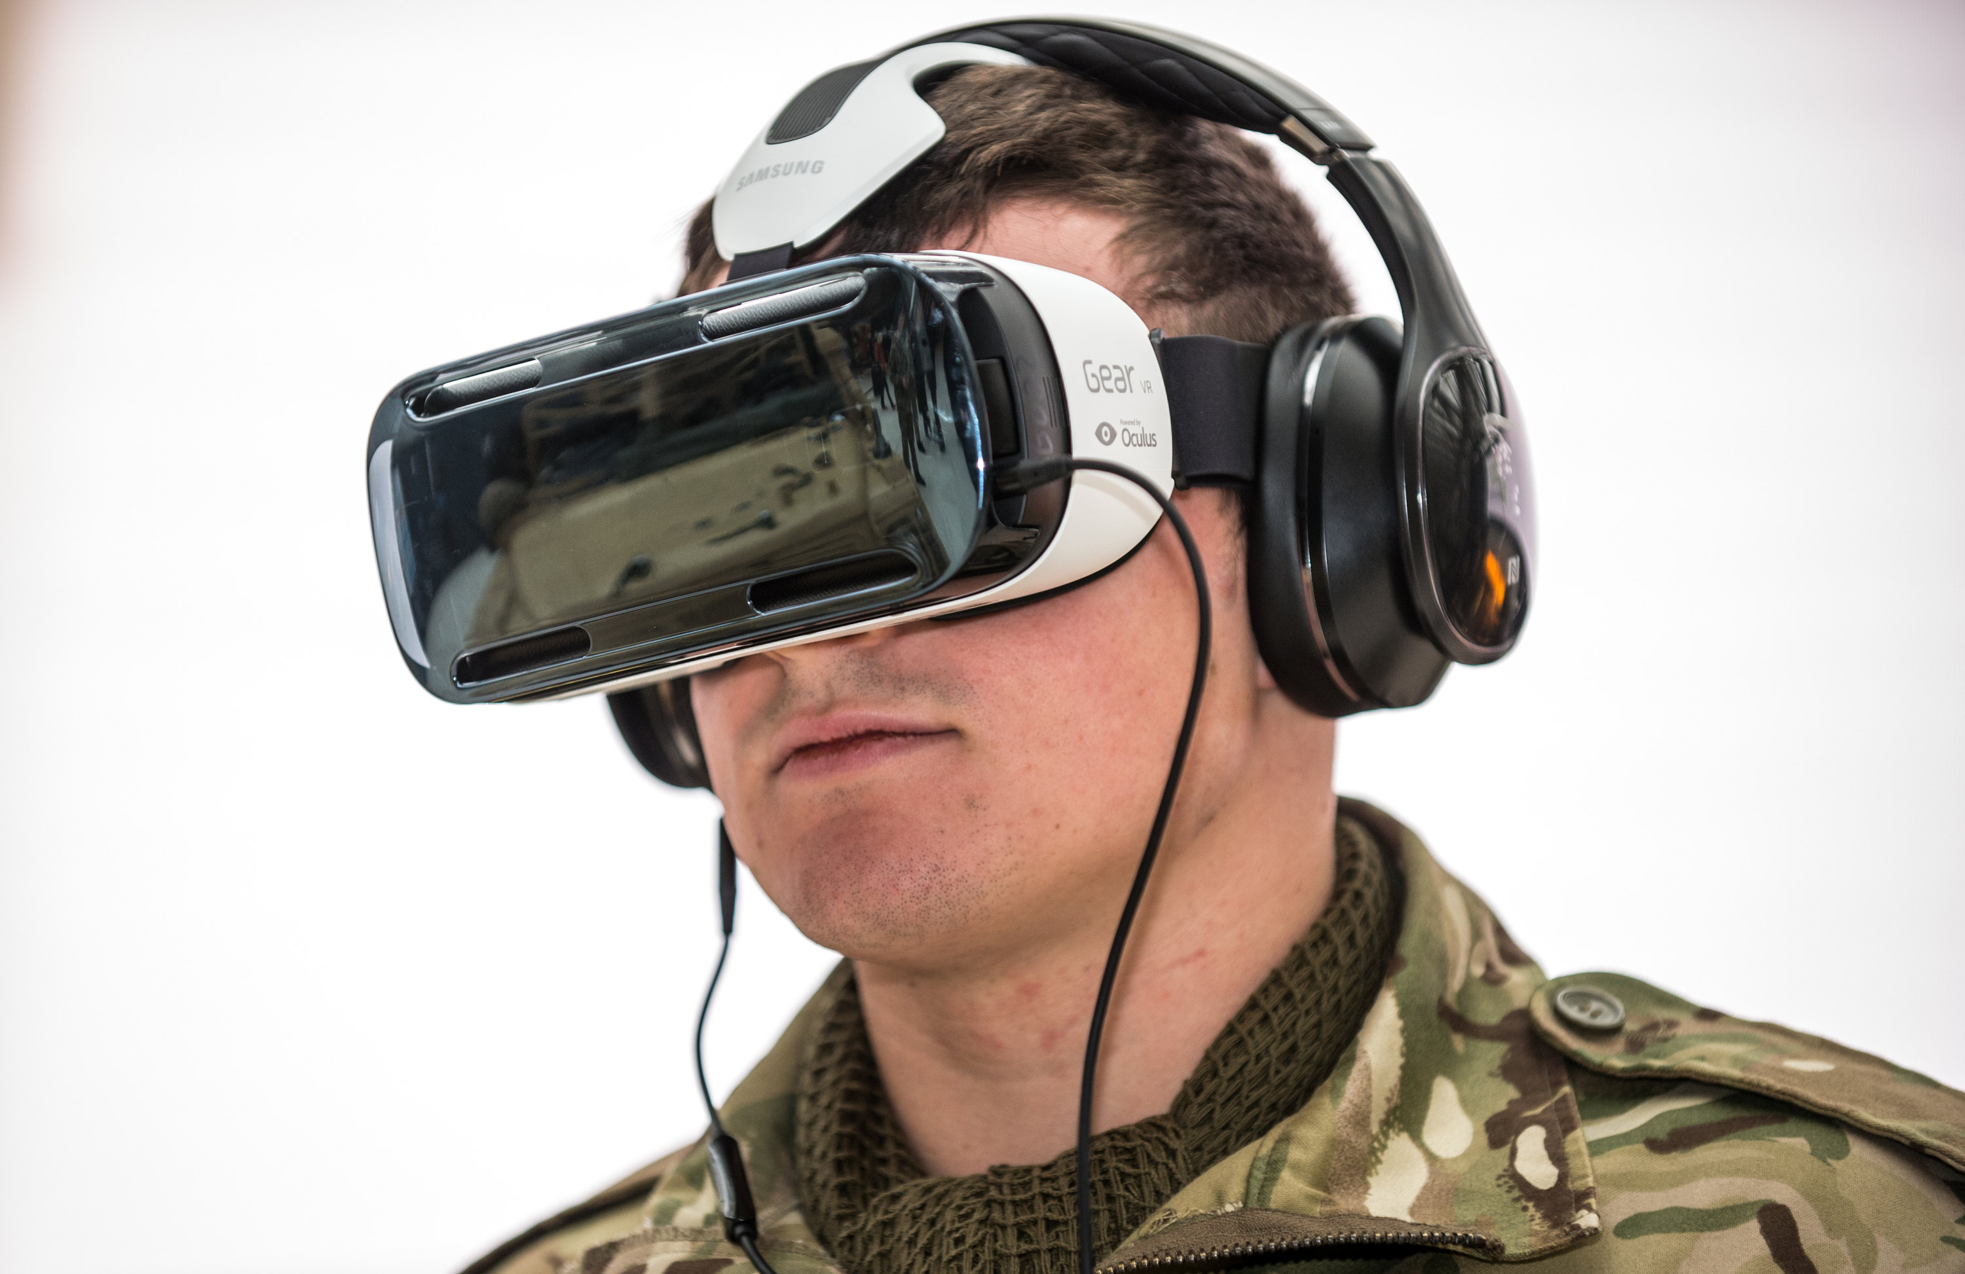
Pre-developed educational VR applications
Over forty efforts in this category where reported.
Nearly three-quarters of the applications are immersive, using either a head-mounted display (HMD) or cave display to visually immerse a user in the virtual world.
There is no collaboration in the virtual world.

Slide 8
Student development of virtual worlds
More than twenty efforts are reported in this category.
The efforts are equally split in their use of either a desktop or immersive VR system.
Most of the worlds have been developed by students working in groups.

Slide 9
What has been found?
Use of both pre-developed VR applications and student development of virtual worlds can be educationally effective.
Students enjoy working with virtual worlds and this experience can be highly motivating.

Slide 10
Teachers report their role in the classroom changing.
Desktop VR is more suitable for widespread use than immersive VR technology.

Slide 11
Important to understand
The studies have concerned one-time use of virtual worlds.
Existing data does suggest that this technology offers significant, positive support for education, it indicates sufficient potential value.

Slide 12


Constructivist learning
Students are better able to master, retain, and generalize new knowledge when they are actively involved in constructing that knowledge in a learning-by-doing insted of teaching-by-telling.

Slide 13
Virtual worlds
Three types of virtual worlds: pre-developed, student-developed, and multiuser. The ratio is, roughly, 13:7:1, with 40 pre-developed applications, 21 student- developed, and only 3 multiuser.

Slide 14
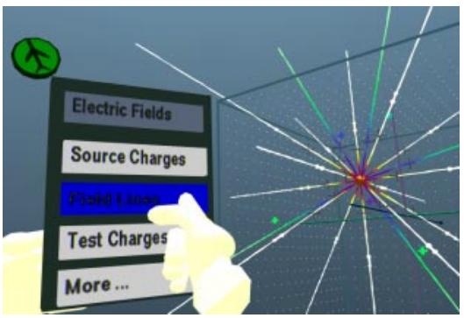
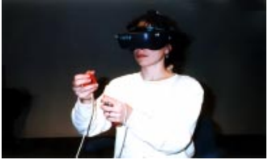
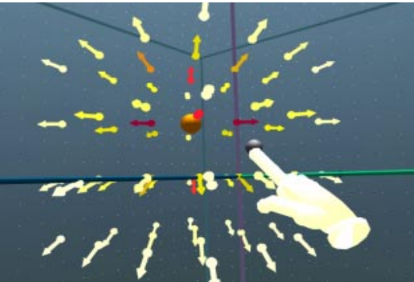
Student use of pre-developed virtual worlds examples
MaxwellWorld – students build 3D electric fields and explore forces and energy by directly manipulating multiple 3D representations.

Slide 15
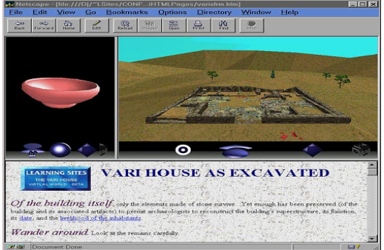
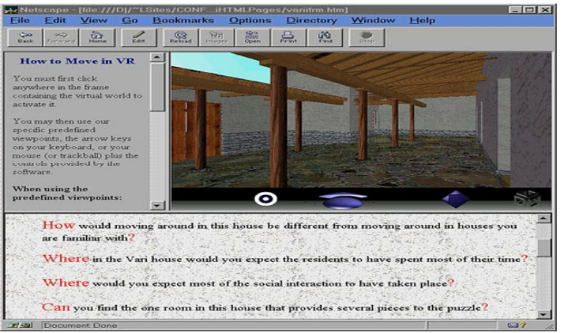
Vari House – two linked virtual worlds show the Vari site as excavated and the Vari house as reconstructed by archaeologists.

Slide 16
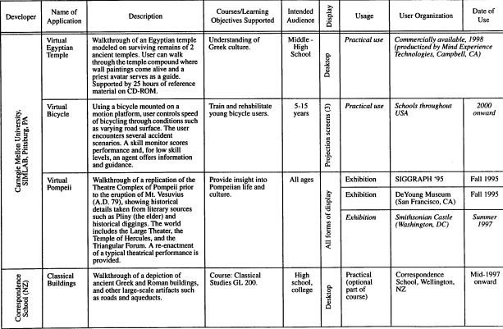

Slide 17
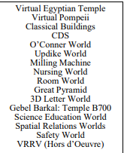
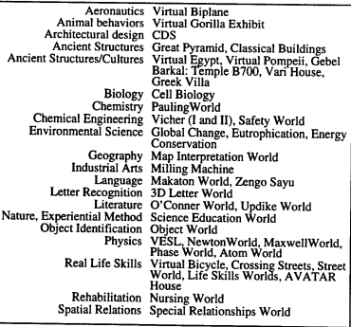
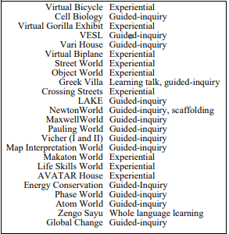
Educational subjects
Pedagogical support

Slide 18
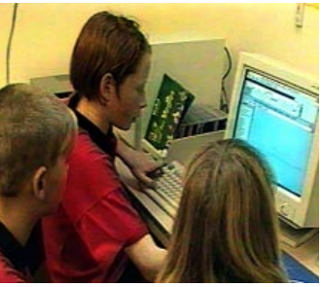
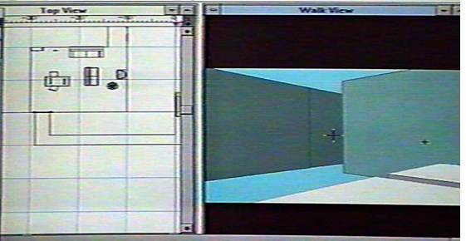
Student development of virtual worlds example
Unit on Antarctica – four students were tasked to design a permanent Antarctica base, large enough for two people.

Slide 19
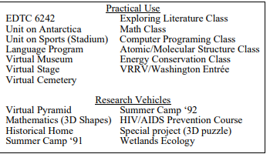
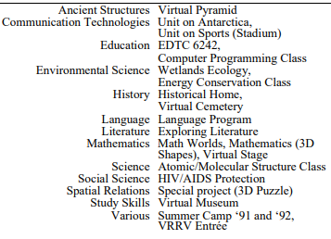
Uses of applications
Educational subjects

Slide 20
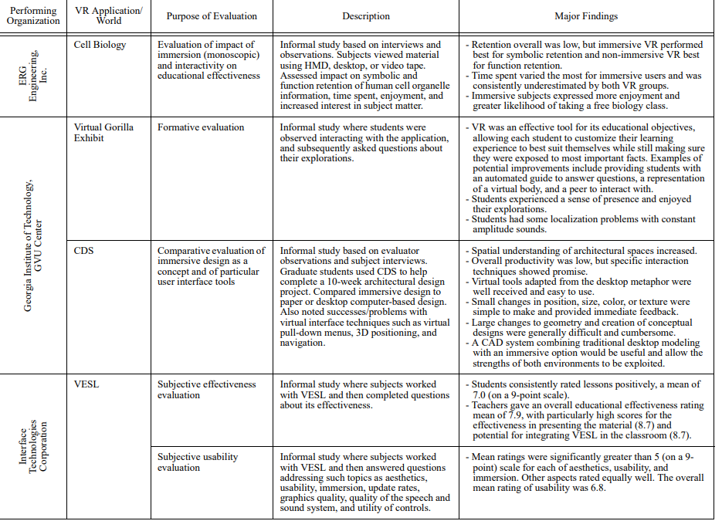
Completed evaluations on the use of pre-developed virtual worlds

Slide 21
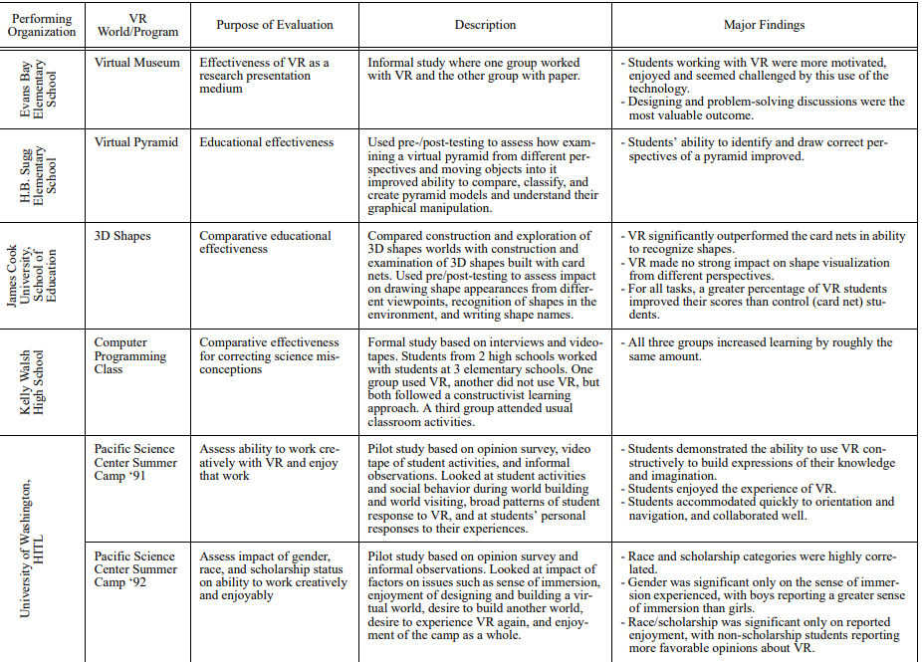
Evaluations of students development of virtual worlds

Slide 22
Conclusion
Instead of memorizing facts, more emphasis should be placed on the higher-level thinking skills.
VR technology is still maturing.
For students VR technology is really engaging.

Slide 23
References
http://papers.cumincad.org/data/works/att/94ea.content.pdf

